Slide 1
MASTERING NEXT.JS
Presented By : Student Leader Syed Shurem Ali

Slide 2

WHAT IS NEXT.JS ?
Next .js is a Full stack React framework you can leverage the mix of frontend and backend at one place it provides great performance, efficiency and developer experience this frame work enables Server Side Rendering (SSR) and Static Site Generation (SSG) making react Application faster and SEO friendly. It also offers built-in features like file-based Routing, API routes and optimize Image handling through Image components from next/image, which simplifies building complex, scalable web applications

Slide 3

What is page.tsx & layout.tsx?
page.tsx:This file represents individual page in the app. Each page.tsx file maps to a route on it folder structure, defining the content and logics or that specific route . Layout.tsx: This file provides that shared layout for pages within a folder, allowing you to wrap multiple pages with common components (like header.tsx and footer.tsx). It’s useful for maintaining consistent layout across section of the app

Slide 4
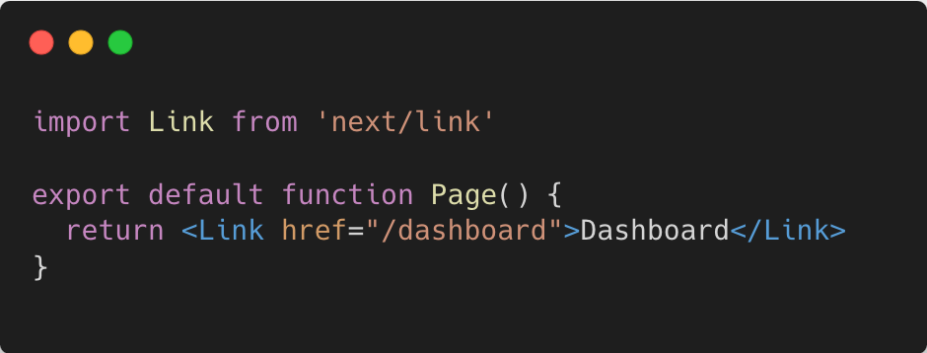
What is the Link components, why do we use this components, and what is its purpose?
A Link component is a pre-built component from next/link that provides smooth client-side navigation from between pages in the applications. Purpose of Link components :It provides away to link to different routes without reloading the entire page, enabling faster transitions and preserving application state. The purpose of the Link component is to enhance the user experience by allowing seamless, efficient within the app.

Slide 5
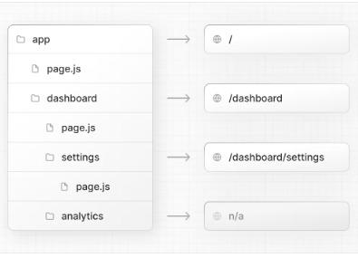
How can we create nested pages in Next.js?
We can create nested routes by creating a sub folder inside a parent route like this: app/foldername/nestedfoldername/page.tsx Benefits: Improves the structure of larger projects by organizing pages logically, making them easier to navigate and manage.

Slide 6
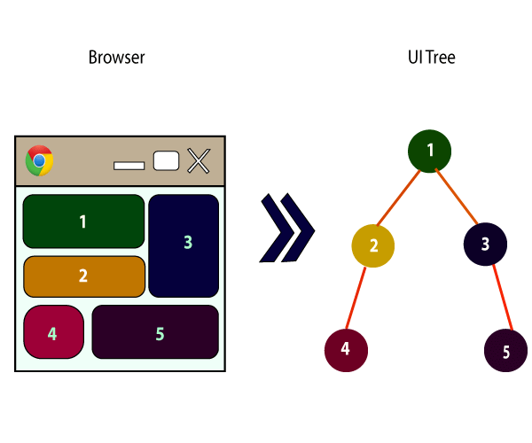
React components

Slide 7
What are components, and why do we use them?
Components are building blocks of React. It is a reusable piece of code for building beautiful user interfaces. You can use these components anywhere in your app by simply import. You can use components in routes and other components as well. Components provide us modularity and efficiency to manage the code seamlessly without getting much into the code. We can add some magic in our components which gives them dynamic behaviour, these is how we can display different data by using single components . This functionality is achieved by using props.

Slide 8
How can we apply CSS in Next.js?
We can apply styling in next.js in various ways just like CSS Module, Global CSS, Tailwind CSS. CSS Module: In css module we apply standard css properties for a specific route in a different file name [“filename.module.css”]. Css modules needs manual optimization. We need to import css module file in that specific route to apply styling.

Slide 9
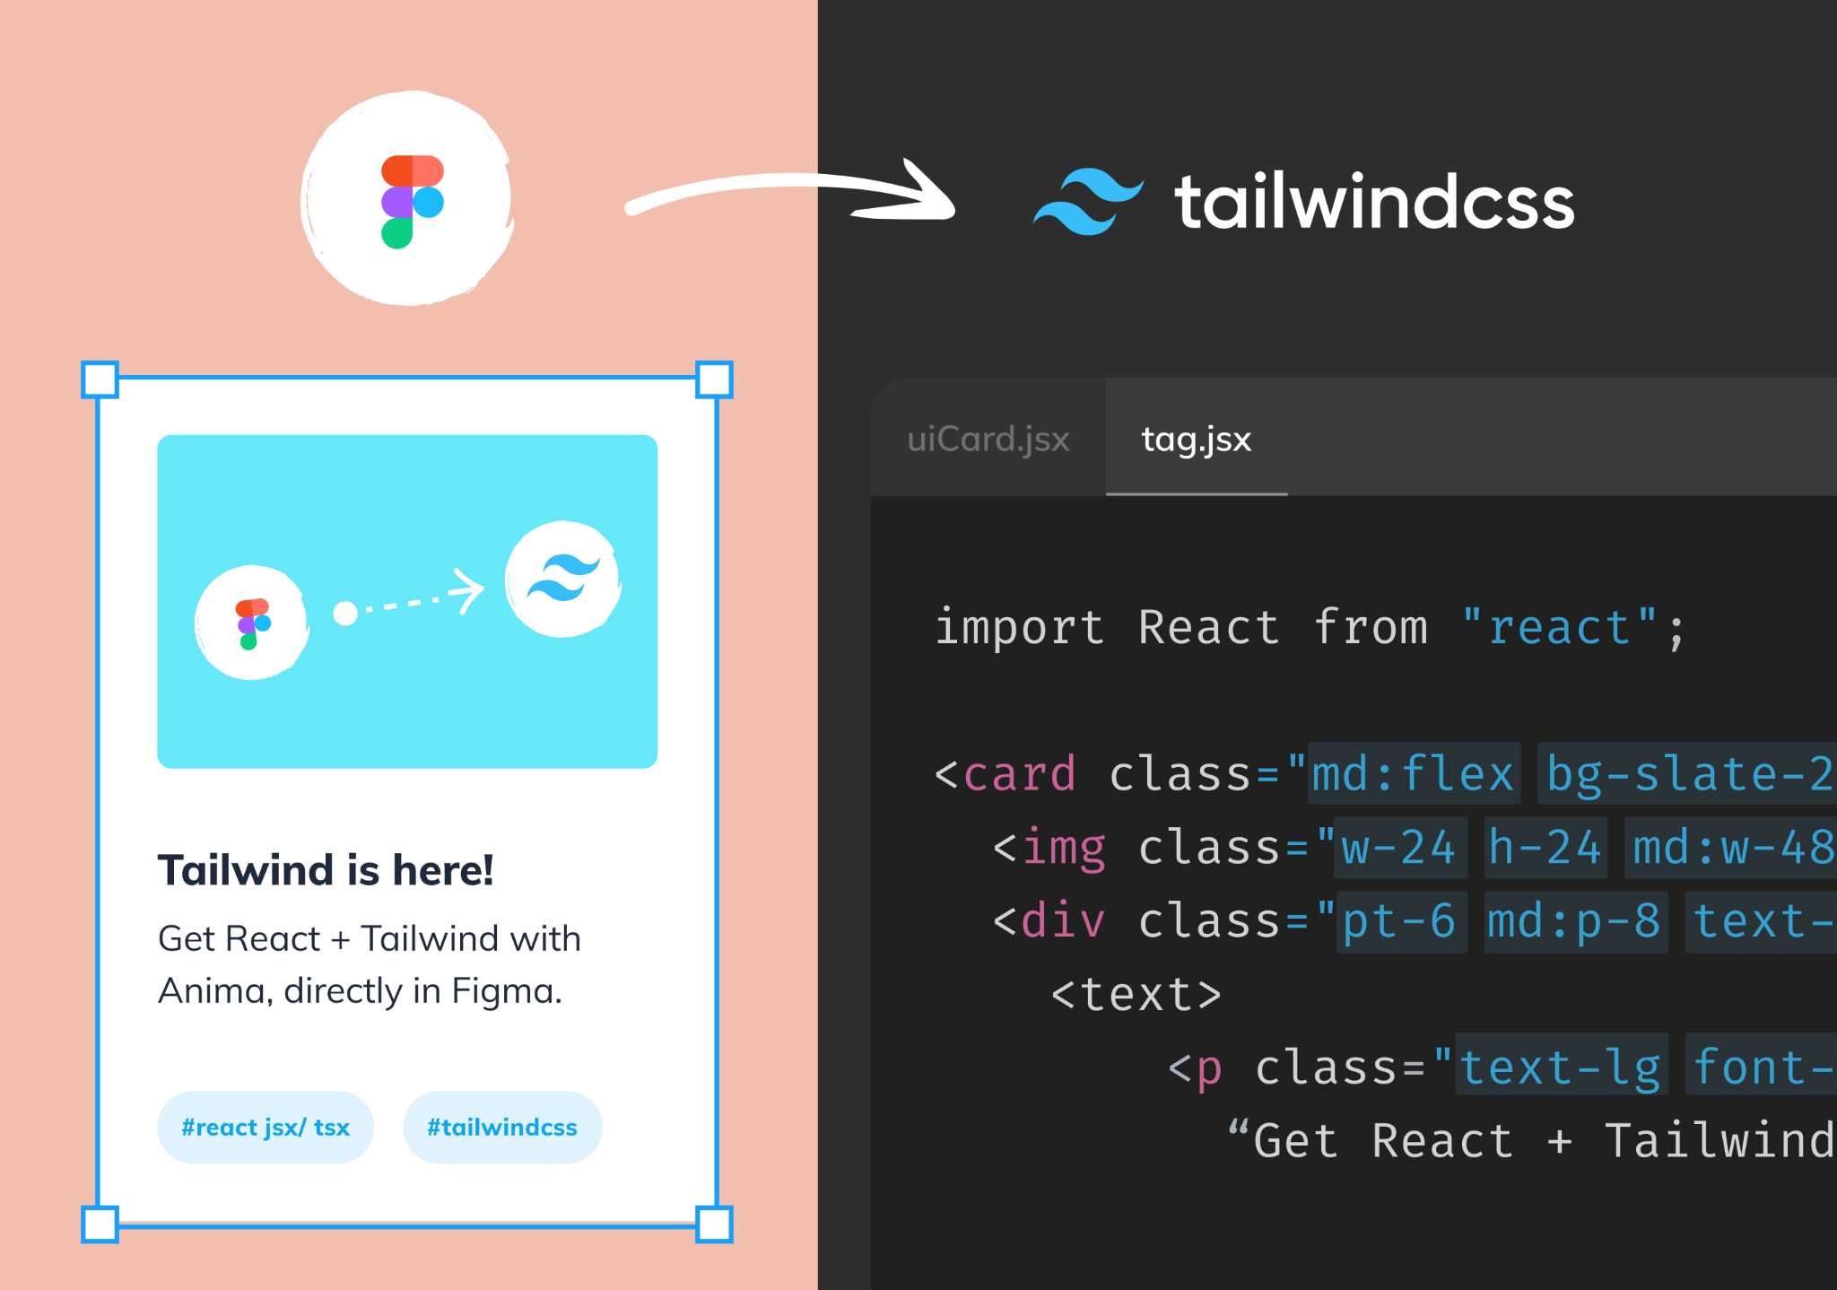
Tailwind CSS: When we run npx create-next-app@14.2.15 it asks us whether we want to use tailwind css in our project or not ? select yes will automatically configured tailwind css in our project. Using tailwind css is super easy we can use tailwind classes like inline css but before that need to define utility directors in global css.

Slide 10
What are the differences between Tailwind CSS and standard CSS?
Approach to style : Writing standard css needs different file for different route while we can apply tailwind css on each elements in a same file. Wokflow : In standard css we need to jump between different file which can sometimes slow down the development process while in tailwind css you can apply classes in direct Jxs which makes at faster to build custom, responsive design without switching different files. Code size: Standard css requires large file that grow with the project, making the code harder to maintain and manage while tailwind classes generate only the classes you use in production, resulting in smaller file size.

Slide 11
Useful links
Routing in next.js: https://nextjs.org/docs/app/building-your-application/routing Tailwind CSS: https://tailwindcss.com/ React components: https://react.dev/learn

Slide 12
Thank you for Reading☺

